Slide 1
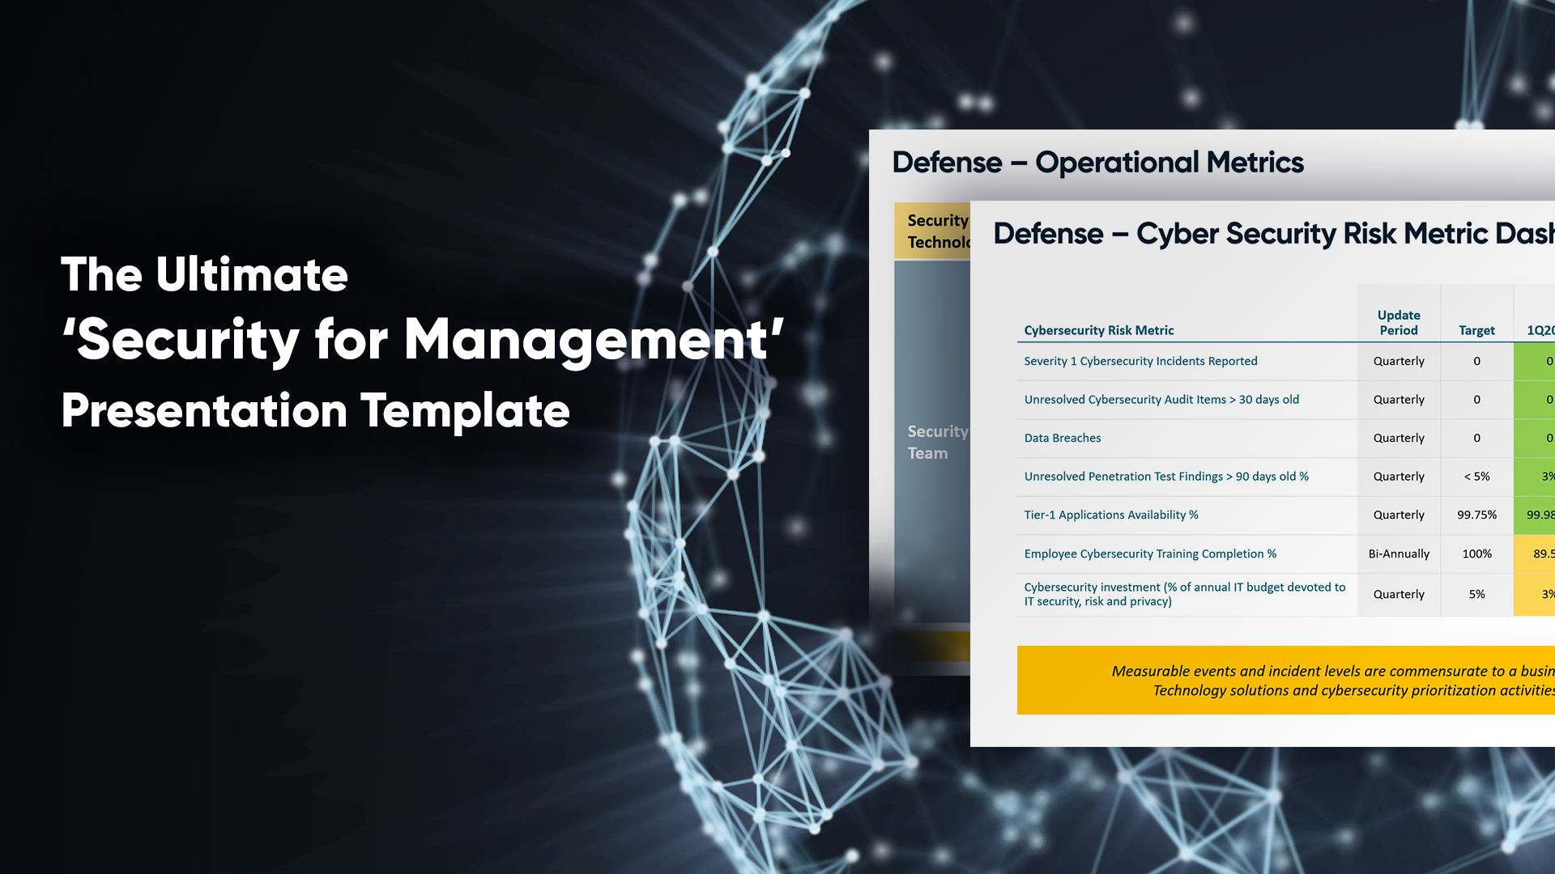

Created by SideChannel

Slide 2

Readme: Slides Guidelines
SLIDE
4 | General framing of NIST framework as common language.
5 | NIST CSF deep dive to use per specific needs.
6 | NIST scorecard. To fill this you must map your existing technologies and procedures to the detailed NIST 800-171 controls’ list. Alternatively, if you’re engaged in a 3rd party assessment, present the interim results. That way or the other, you’ll need to populate a NIST 800-171 controls’ spreadsheet to aggregate into a bar chart.
7 | Map the various security stakeholders within your organization + description of delivered success.
8 | Operational metrics, divided to two parts: Security technologies – the example in this slides includes events from firewall and endpoint. In real life you’ll include the outputs of your entire security stack. Security team - overall number + selected examples. We suggest to pick three that represent the events in the given timeframe. Each example can trigger elaboration on the related security risk and needs.
9 | Concise risk metric dashboard that you fill according to your security posture.

Slide 3
Agenda
Cyber Security Strategy
NIST Cyber Security Framework Scorecard
Cyber Security Governance
Defense – Operational Metrics
Defense – Risk Matrix Dashboard

Slide 4
Cyber Security Strategy
Design, implement and continually improve a cyber discipline aligned to the National Institute of Standards and Technology cybersecurity framework (NIST CSF)
IDENTIFY
PROTECT
DETECT
RESPOND
RECOVER

Slide 5
NIST CSF
Deep Dive
BUSINESS OPPORTUNITY | KEY ENABLERS
Develop the organizational understanding of cybersecurity risk to manage it and its impact on systems, data, employees, and capabilities. | Business Context Asset Management Governance Risk Assessment Risk Management Strategy
Develop and implement the appropriate safeguards to ensure delivery of critical infrastructure services. | Access Control Awareness and Training Data Security Information Protection Policies and Procedures Proactive Maintenance Protective Technology
Develop and implement the appropriate activities to identify the occurrence of a cybersecurity event. | Anomaly and Event Detection Security Continuous Monitoring Detection Processes
Develop and implement the appropriate activities to take action regarding a detected cybersecurity event. | Incident Response Planning Communications Analysis Mitigation
Develop and implement the appropriate activities to maintain plans for resilience and to restore any capabilities that were impaired due to a cybersecurity event. | Incident Recovery Planning Communications
IDENTIFY
PROTECT
DETECT
RESPOND
RECOVER

Slide 6
NIST Cyber Security Framework Scorecard
21 days
34 days
NIST CSF Metric | Start | Current | Target | Trend
Controls Met | 35% | 55% | 80% | Improving
8 days
54 days
36 days
5 days
43 days
Met
Partially Met
Not Yet Met
2017
Notes:
This slide uses an excel sheet behind the chart to show percentages of met, partially met, or not met controls against the NIST CSF.

Slide 7
Cyber Security Governance – One Company, One Mission
RISK PRIORITIZATION
SUCCESSES DELIVERED(xQ20xx)
Topic Area 1 | Include brief description of success seen by business and how it reduced risk
Topic Area 2 | Include brief description of success seen by business and how it reduced risk
Topic Area 3 | Include brief description of success seen by business and how it reduced risk
Topic Area 4 | Include brief description of success seen by business and how it reduced risk
Topic Area 5 | Include brief description of success seen by business and how it reduced risk
Employee – Title
Employee – Title
Employee – Title
ENTERPRISE RISK MANAGEMENT
STRATEGY & GOVERNANCE
DATA SECURITY & PRIVACY COMPLIANCE
Employee – Title
Employee – Title
Employee – Title
TECHNICAL EXECUTION
Employee – Title
Employee – Title
Employee – Title
INFORMATIONTECHNOLOGY

Slide 8
Defense – Operational Metrics
Security Technologies | Perimeter firewalls blocked XXX inbound events Endpoint controls blocked XXX events Other (email protection, IDS, etc.) identified\blocked XXX events
Security Team | Overall Number of incidents: | XXXX
 | Selected Examples | Employee account compromise example | Description: Employee clicked phishing link and submitted username/password Analyst responded to compromise and recovered operations for employee
 |  |  | Elaboration point: data or PII lost and impact
 |  | Malware installation via malicious advertising website | Description: Employee’s laptop was vulnerable to exploit and was compromised Analyst detected malware, contained, and quarantined laptop Analyst worked with Helpdesk to recover operations for employee
 |  |  | Elaboration point: time lost for desktop support team to remediate and business impact to use
 |  | Employee accessed or attempted access to prohibited websites | Description: Analyst detected attempts, researched incident and monitored employee Employee’s network history and / or laptop is secured for HR investigation Analysts work with HR and / or Legal
 |  |  | Elaboration point: insider threat, IP loss, or reputation damage
Technology solutions and resource investments are proving to be effective

Slide 9
Defense – Cyber Security Risk Metric Dashboard
21 days
Cybersecurity Risk Metric | Update Period | Target | 1Q2018 | 2Q2018 | 3Q2018 | 4Q2018 | Trend
Severity 1 Cybersecurity Incidents Reported | Quarterly | 0 | 0 | 0 |  |  | Steady
Unresolved Cybersecurity Audit Items > 30 days old | Quarterly | 0 | 0 | 0 |  |  | Steady
Data Breaches | Quarterly | 0 | 0 | 0 |  |  | Steady
Unresolved Penetration Test Findings > 90 days old % | Quarterly | < 5% | 3% | 0% |  |  | Improving
Tier-1 Applications Availability % | Quarterly | 99.75% | 99.985% | 100% |  |  | Improving
Employee Cybersecurity Training Completion % | Bi-Annually | 100% | 89.5% |  |  |  | Steady
Cybersecurity investment (% of annual IT budget devoted to IT security, risk and privacy) | Quarterly | 5% | 3% | 3.5% |  |  | Improving
34 days
8 days
54 days
36 days
5 days
43 days
2017
Measurable events and incident levels are commensurate to a business of our size and industry sector.
Technology solutions and cybersecurity prioritization activities are proving to be effective.

